Slide 1
Goals and challenges for APC-based publishing models at the California Digital Library
Mathew Willmott
California Digital Library
3rd ESAC Workshop:
On the Effectiveness of APCs
June 29, 2018

Slide 2
About CDL/UC

Slide 3
About CDL/UC: Background
Serves 190,000 faculty and staff and 239,000 students across the 10 campuses of the University of California system
(among many other functions) negotiates licenses for content access for all campuses for major publishers.
Publishing output accounts for about 2% of the world’s publication volume (about 8% of the US publication volume).
Green OA policies starting in 2013

Slide 4
About CDL/UC: Internal Drivers
OA2020
Pathways to OA
Pay-It-Forward
Move-It-Forward
Declaration of Rights and Principles to Transform Scholarly Communication
Negotiating Journal Agreements at UC: A Call To Action
Commitment to a multi-pronged approach (including APC-based models as a strategy to transform existing subscription publishers to OA)
Notes:
Animate this for each item to pop up in sequence, with image below.

Slide 5
Challenges of APC-based models in the US

Slide 6
Challenges of APC-based models in the US
US higher education system is decentralized and heterogeneous. Therefore:
Institutions are generally operating on their own; consortia are at best regional and usually negotiate opt-in licenses.
Grant funding flows through authors rather than through direct partnerships between institution and granting agency.

Slide 7
Challenges of APC-based models in the US
2) National grant funding agencies are showing no signs of getting involved in immediate OA mandates:
Current policies are green (e.g. submission to PubMed Central)
Most allow APCs to be charged to grants but make no requirements for this.

Slide 8
Challenges of APC-based models in the US
3) Conclusions from the Pay-It-Forward project:
Under competitive market conditions in an APC-based model, high-output research-intensive North American institutions are likely to shoulder a larger burden for scholarly communication than in the subscription model
In general, this extra burden could be addressed by incorporating funding from research grants where available.

Slide 9
Challenges of APC-based models in the US
4) Author impressions (correct or not):
OA is generally a Good Thing, but:
Not enough to change where I want to publish
Everybody that needs to read my article sees it anyway
Paying to publish is equivalent to vanity publishing
OA journals imply lesser quality
University is abdicating its responsibilities when authors need to make APC payments

Slide 10
Challenges of APC-based models in the US
5) Concerns from institutions or libraries:
A transition to APC-based OA models gives more market power to publishers
Authors will place price pressure on their own institutions rather than on publishers
Offsetting agreements are normalizing hybrid publication
APC based models are maintaining commercial for-profit publishers in the marketplace
The cost will be too great for our institution to bear
Incentives created for publishers will be in conflict with the needs of academia (new journals, higher acceptance rates)
We can do this cheaper through green policies
etc. etc. etc.

Slide 11
Strategies for creating a model to support an APC-based transition to OA

Slide 12
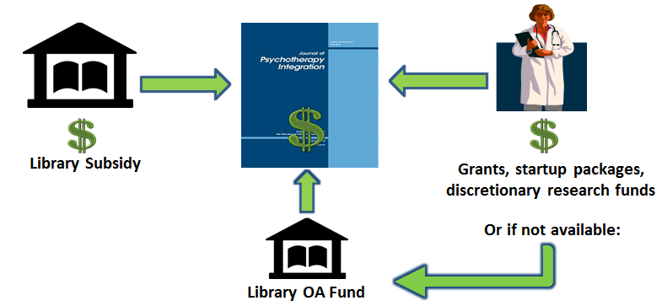
Strategies for creating a model
1) APC payments by author:
Incorporates grant funding via the author
Involves authors in the process, starting to socialize them with the economics and incorporate their price sensitivity
Doesn’t require additional money out of their pocket
Maintains library’s relationship with the publisher
Support model extensible across other publishers (including full OA)

Slide 13
Strategies for creating a model
2) General financial structure:
Based around containing our current costs
Not willing to increase our financial outlay without
Clear decreases elsewhere
Evidence of transition in the model
Mechanisms may allow that in the future

Slide 14
Strategies for creating a model
2) General financial structure - systemwide:
Current Model
Potential New Model
Grant available
No grant
Two variables:
APC size
Subsidy size
Subscription journals
OA journals
Blue = Library Spend
Total
Green = Grant Spend

Slide 15
Strategies for creating a model
2) General financial structure - systemwide:
Current Model
Potential New Model
Grant available
No grant
Two variables:
APC size
Subsidy size
Goal:
Library spend approx. same in current and new models
Subscription journals
OA journals
Blue = Library Spend
Total
Green = Grant Spend

Slide 16
Strategies for creating a model
2) General financial structure – individual publisher:
Control overall spend with publisher
Publication volume is estimated, but risk is capped on both sides:
Publish over maximum (~2% over estimate): content still made OA at no additional cost
Publish under minimum (~2% under estimate): UC still pays minimum fee
Results:
Costs are controlled and predictable
Author experience is consistent
Spend varies with publication volume

Slide 17
Strategies for creating a model
3) Building transitional language into the agreement
Key for partnership with publisher: ensure that there is a shared understanding of the goal
MIT/RSC example:
“transitional business model whose aim is to provide a mechanism to shift over time to full open access.”
Other ideas:
A percentage of journals is converted to full OA in a given time period
A named subset is converted to full OA in a given time period
A journal is converted to full OA when the percentage of OA content in the journal reaches a certain threshold

Slide 18
Strategies for creating a model
4) Messaging and education
For faculty: understand the model, our goals, and why they will start to see APCs on certain journals
Externally: try to create support for the model in the community, identify other institutions or consortia to implement a pilot of their own

Slide 19
Strategies for creating a model
5) Additional risks:
Increasing administrative burden on authors
Incentivizing authors to choose different journals, or to opt out
Incentivizing authors to choose these hybrid journals rather than full OA journals
Impacting editorial behavior
Impacting publisher price-setting behavior

Slide 20
…that we as libraries must work together to mitigate
Overall risks

Slide 21
Overall risks
Disadvantaging full OA publishers or other small mission-driven publishers. How to mitigate this risk?
Ensure that models we implement are extensible to these publishers.
Stress test our overall models to observe their impacts on these publishers
Collaborate with these publishers to understand how we can implement an APC-based or other alternate model with them

Slide 22
Overall risks
Disadvantaging institutions or countries with little funding available for APC payments How to mitigate this risk?
Further research (similar to the Pay-It-Forward study) to observe the impact of APC-based models on small institutions and/or the Global South
Collaboration with representatives from these institutions or nations to determine the appropriate strategy for model implementation

Slide 23
Overall risks
Potentially unsustainable/unjustifiable price increases in APCs How to mitigate this risk?
Observe APC-setting behavior, avoid using agreements to normalize prices that are unsustainable
Combat the drive of legacy subscription publishers to replicate their current revenue in an APC-based model – encourage and incentivize appropriate cost-setting

Slide 24
Overall risks
Predatory publishing (not a new problem, but using new strategies) How to mitigate this risk?
Author education and messaging
Collaborative work across institutions: possible certification system
Local approach analogous to collection-building

Slide 25
Overall risks
Enshrining the hybrid model as a new permanent fixture in the subscription system How to mitigate this risk?
Collaborate on language used to extract transitional commitments from publishers
Advocate within the library community for increased uptake to move closer to a full transition

Slide 26
Overall risks
Models which are not compatible across different contexts or geographic regions How to mitigate this risk?
Continued communication and collaboration across all areas working on this problem
Concerted effort to draw in representatives from other approaches, regions, backgrounds

Slide 27
Thank you!
Questions?
Mathew Willmott
mathew.willmott@ucop.edu

