Slide 1
Jisc Monitor and APC data collection
Graham Stone

Slide 2
Introduction to Monitor services:
Monitor Local
Track research outputs
Check compliance with funder mandates
Manage associated costs (APCs)
Report on costs of Open Access
Monitor UK
Collates national data on APC payments
Review, benchmark & plan spending
Feed into Jisc Collections
Notes:
A brief introduction to the systems and their functions.
Monitor Local is a system to help institutions track their research outputs – the publication details, stages of the publication process; a compliance checker, clearly showing whether a particular output has met the required funder criteria; and most importantly, a system to manage the costs of article processing charges and all other costs associated with open access publishing. (Including budgets, grants and invoices.)
One of the most significant benefits to users – is ability to produce pre-set reports on their APC spend, in the standardised formats require for submissions to funding bodies and now also to Jisc Collections.
Monitor UK is a separate, but linked, system, which pulls together APC data from Monitor Local providing a national picture of APC spending against publishers, funders and individual institutions. It is completely optional for institutions to share their data with Monitor UK. Both of the Monitor systems are part of Jisc’s OA services, which are part of our core offering to all members, so no extra cost is incurred to make use of these.

Slide 3
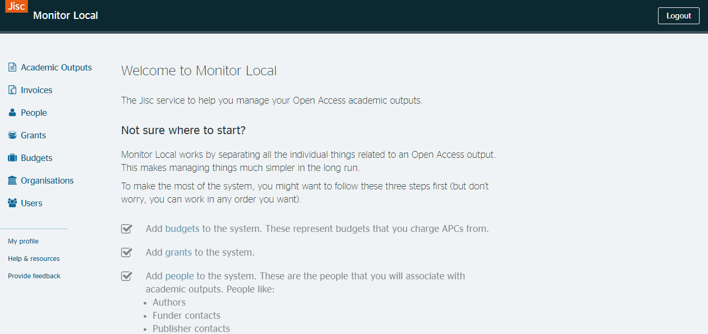
Notes:
Monitor Local homepage – users sign in via their existing Shibboleth details, and each new user is approved following confirmation from the account contact at each institution.
You will see a list of options on the left-hand side – these are the various entities that are recorded in Monitor, with Academic Outputs being the core component of the system, to which all other entities are linked.

Slide 4
Notes:
Each entity type has a ‘Manage screen’ from where you can search and filter your records, as well as download your records in CSV or Excel format. From here, you can also move to the ‘Report’ page, where you can select from pre-set reports for submission to funders (at present, we have pre-set RCUK, COAF and also Jisc APC spreadsheet reports)

Slide 5
Notes:
This is the homepage for Monitor UK, the linked ‘sister’ site to Monitor Local as mentioned earlier – from here you can conduct searches for APC data, and view reports…

Slide 6
Notes:
… and this is an example of the sort of view and information provided within the reporting tools in Monitor UK. Here you can see a chart comparing the number of APCs paid by institutions to particular publishers.

Slide 7
Recent & upcoming new features
Nov 2017 (v1.6): Introduction of RCUK (now UKRI) and COAF reports
Reports compiled according to RCUK (UKRI) and COAF requirements
Incremental updates including improved usability, addition of automatic currency conversion, importing of journal titles via KB+
July 2018 (v1.11): Total Cost of Ownership (TCO) spreadsheet import and export tools
Ability to upload and back-fill records
Automated creation of Jisc TCO spreadsheet & less duplication of work
Improve data available to Jisc Collections
Notes:
Monitor Local was the result of a 2 year pilot project, and transitioned to a Jisc service in October 2016 – followed by a year of considerable development, leading up to Nov 2017 & deployment of v1.6 which brought much improved reporting functionality.
Since then, incremental updates have included enhancements to the workflows, usability, addition of features such as DOI importing of publication details, automatic currency conversion for APCs paid overseas, and importing of publication information from Knowledge Base +.
Uptake of the system has steadily increased, and we now have 23 UK HEIs fully signed up & using the system, along with 2 others currently trialling (as of end of June 2018).
We are now testing v1.11 (due to go live in early July) which is another significant update to the system. This will bring in the ability to both import and export spreadsheets in the standard ‘Jisc TCO’ format – allowing institutions with historical information stored in this format to upload it, and improve the process for institutions to easily pull off a report of their APC data in this format.
Moving forward, we have taken feedback from users and will soon be launching further customisable reporting options, and integrations with other systems and services.

Slide 8
Jisc APC data collection

Slide 9
Collecting APC data
Each year, Jisc Collections asks UK higher education institutions to provide details of their APC transactions
Uses a standardized format
Makes the data openly available
Started in 2013 with 17 organisations
We now have has data on:
36,000 individual APCs
From 53 unique institutions between 2013 and 2017)!
45 responses in 2018

Slide 10
Why do we ask for all that data – and what do we do with it?

Slide 11
1) We use it in negotiations

Slide 12
1) We use it in negotiations
We have the opportunity to create a more transparent market for OA
Complete information on expenditure – including subscription, colour page charges, and APCs – allows Jisc Collections to understand how much additional money is being spent outside traditional routes
Jisc Collections uses this data to build models which increase immediate open access publishing whilst keeping the overall costs down
We use the data in the Total Cost of Ownership reports
Lawson, S. (2017) Report on offset agreements: evaluating current Jisc Collections deals. Year 2 – evaluating 2016 deals. DOI: https://doi.org/10.6084/m9.figshare.5383861.v1

Slide 13
Offsetting deals in 2018
Cambridge University Press
Oxford University Press
Springer Compact
Taylor & Francis
Institute of Physics
Royal Society of Chemistry
Wiley
Sage
American Chemical Society
De Gruyter
Notes:
Used to negotiate offset deals, and to evaluate them once they’ve been implemented

Slide 14
2) It’s used in research all over the world

Slide 15
2) It is used in research all over the world
All data published on Figshare under CC0 licence
Feeds into OpenAPC dataset ☺
Helps to grow knowledge and conversation around the costs of open access

Slide 16
3) It’s used to inform OA policies

Slide 17
3) It is used to inform OA policies in the UK
UKRI and COAF use the same template and use the data to evaluate and revise their policies
Data has been cited in UK policy documents, e.g. Dr. Adam Tickell’s report to the UK Government on open access
Used as the basis for research articles
e.g. UUK report ‘Monitoring the Transition to Open Access’

Slide 18
The benefits of open APC data
Making APC data open has made a measurable impact towards advancing open access
It’s helped to:
Negotiate better deals with publishers
Spark conversations worldwide about the costs of open access
Inform the policies that shape the future of scholarly communication
Sharing APC data, helps to make the OA neighbourhood a more open, navigable, and friendly place

Slide 19
Further information
Karen Jackson
Senior OA Support Coordinator
Karen.Jackson@jisc.ac.uk
https://monitorlocal.jisc.ac.uk https://monitoruk.jisc.ac.uk/

