Slide 1
Pricing from an open-access publisher’s perspective
The example of Copernicus Publications
Dr Xenia van Edig
Copernicus Publications | 28 June 2018

Slide 2
History of Copernicus Publications
Founding of Copernicus in 1988 as a spin-off of the Max-Planck- Institute for Solar System Research
Organization of scientific meetings & conferences since 1988
1994 start of Copernicus Publications
2001 start of the first open-access society journal, followed by the move of the other journals towards OA
2018 Copernicus Publications publishes 41 peer-reviewed open access journals and peer-reviewed proceedings and 20 access- reviewed scientific discussion forums
37 journals owned learned societies and other scientific organizations
52 staff members, offices in Göttingen/Germany
Co-founder of OASPA, member of stm, member of ORCID, member of COPE, partner of OpenAiRE
4,863 articles | 3,650 discussion papers in 2017

Slide 3
Why we are different from most other publishers
Insourcing
Staff costs vs. costs for third parties
Development work for review system done in-house
Publishing services for learned societies and other scientific institutions
No in-house scientific editors
No ownership for 90% of the journals
APCs: joint decision with customers

Slide 4
Workflow I
Each journal has its own domain and corporate design
Registration of domains for website and journal library
Own look and feel: in-house graphic designer
Own editorial support system
Copernicus Office Editor: review system
High degree of customization
1 in-house developer
Editorial Support
File validation (technical checks, e.g. plagiarism screening)
Personal support for editors, authors and referees during the peer review process
4 editorial support officers

Slide 5
Workflow II
Production file validation + typesetting + image processing
LaTex, early conversion in XML
20 typesetters, thereof 3 also do image processing + 1 graphic designer
English language copy-editing
Native speakers with scientific back ground
13 copy editors
Online publication
DOI registration
Journal library and distribution to indexing services, databases, repositories
1 developer
Invoicing
Invoice changes, splittings, etc.
1 accountant

Slide 6
What else I?
10% free pages for waivers
Long-term archiving with Portico, CLOCKKS, German National Library, Gottfried Wilhelm Leibniz Library
Media and Communications
Twitter channels, news items, community mailings
Promotion
Promotion material, exhibitions booths …
Indexing
Application process
Control if content is available (subscriptions for Web of Science and Scopus)
Credit-card fees for APCs

Slide 7
What else II?
Office infrastructure
Policies: data, publications ethics, competing interest, etc.
Further education of staff
Features: asset tab, full-text html, enhancements of CO Editor, etc.
COPE membership of all journals
ORCID integration
No set-up costs for new journals

Slide 8
Business model
Learned society/scientific institutions retain ownership
License contracts
Licenses fee: APC income + income from print subscriptions minus internal APCs that cover Copernicus’ costs
Owner can subsidize journals or can generate income for their outreach, to launch new journals, etc.
Forwarding of internal APCs to the authors
Central Payment of APCs by journal owner
APCs higher or lower than internal APC -> Positive of negative license fee
Revisit of agreed initial Copernicus APCs after 3 years (comparison with actual costs of the journal)
Current internal APC
One stage: €55/€60 net per page
Two stage: €69/75 net per page

Slide 9
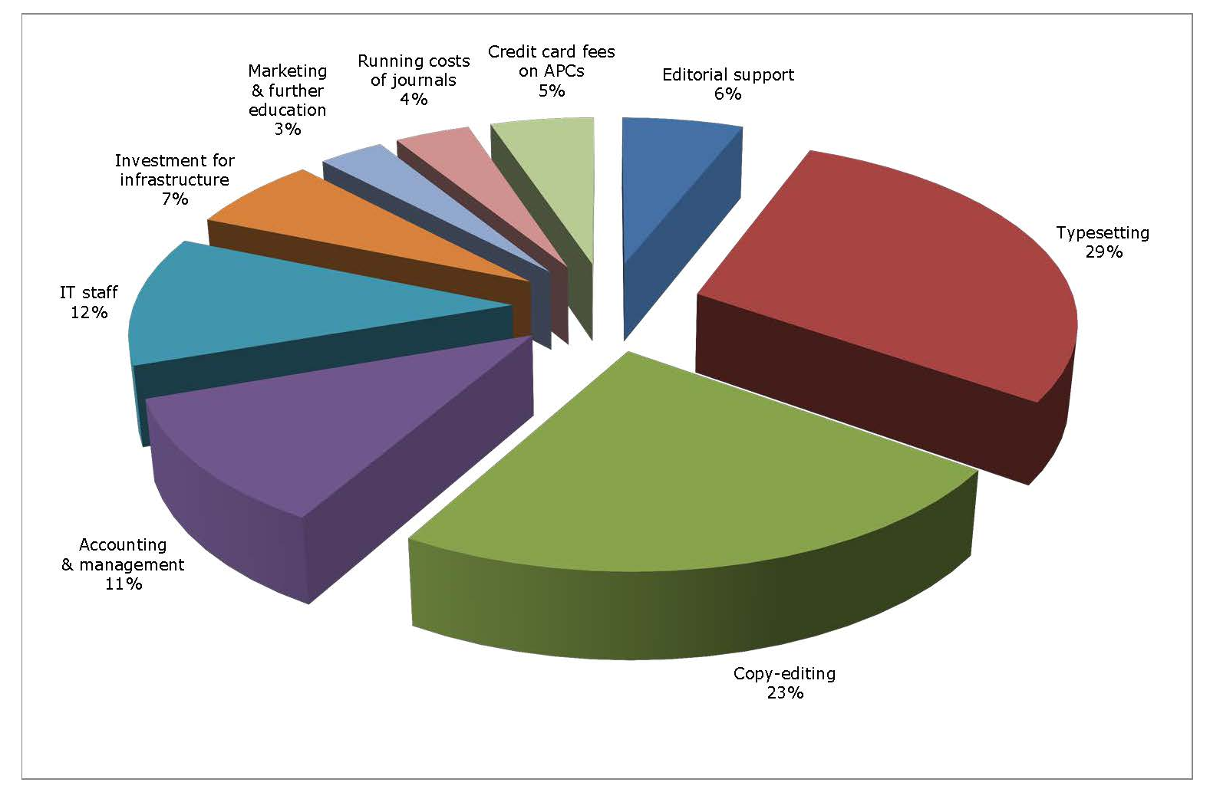
Copernicus Publications cost structure 2017

Slide 10
Conclusions
Salaries and office infrastructure for editorial support, typesetting, and copy-editing staff account for 58% of Copernicus’ costs
Indirect costs for salaries and office infrastructure of IT staff, accounting and management, and the acquirement of hard- and software contribute 30% to costs
Running costs for DOIs, plagiarism check, archiving, and indexing are comparatively low with 4%
Direct promotion costs, costs for representation and travelling, and further education of staff are low as well with 3 %
Credit-card fees on APCs account for 5% of the costs

Slide 11
Thank you very much for your attention!
@XeniavanEdig
@copernicus_org
xenia.van.edig@copernicus.org

