Slide 1
OpenAPC: A contribution to a
transparent and reproducible monitoring of fee-based open access publishing
3rd ESAC Workshop | June 28-29, 2018
Dirk Pieper (Bielefeld UL)

Slide 2
Agenda
OpenAPC
Results so far
Springer Compact analysis
Use and reuse of OpenAPC
Cost data and price building on the APC market

Slide 3
INTACT („transparent infrastructure for open access publication fees“) funded by German Research Foundation (DFG) for 3 years (until 09/2018)
Partners: Bielefeld UL, Max Planck Digital Library, Institute for Interdisciplinary Studies of Science (I²SoS, Bielefeld U)
Support: DINI working group Electronic Publishing

Slide 4
Further funding by Federal Ministry of Education and Research (BMBF): „Förderrichtlinie des freien Informationsflusses in der Wissenschaft – Open Access“
Additional international funding: OpenAIRE Advance - WP 6 „Towards a scholary commons“, subtask 6.3.3

Slide 5
OpenAPC goals
to release datasets on fees paid for oa journal articles under an Open Database License
to demonstrate how reporting on fee-based Open Access publishing can be made more transparent and reproducible across institutions
to provide valid APC cost data for oa transformation

Slide 6
OpenAPC approach
Require as less as information as possible from contributing institutions, see Data Submission Handout and OpenAPC schema
Use Crossref API to normalise bibliographic metadata (via DOI )
Enrich identifiers (ISSNs, PMID, PMCID, UT)
Continous data integrity testing

Slide 7
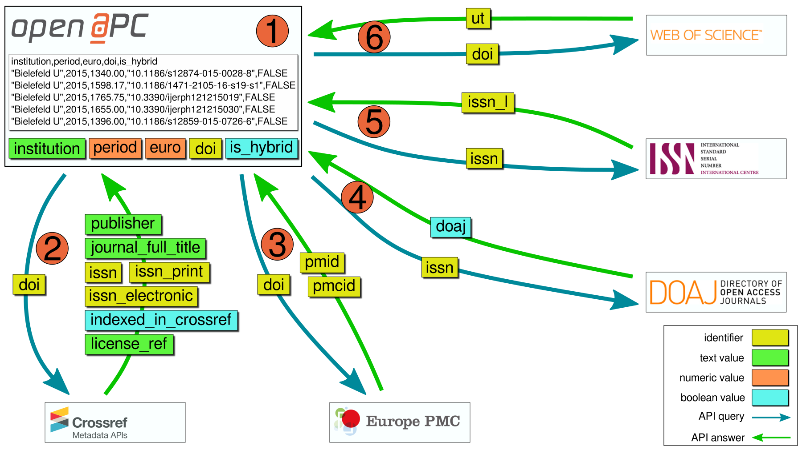
OpenAPC approach
OpenAPC enrichment overview

Slide 8
Data dissemination
Raw data and versions via GitHub
GitHub readme
OpenAPC blog
Treemap visualisation via OLAP server

Slide 9
Agenda
OpenAPC
Results so far
Springer Compact analysis
Use and reuse of OpenAPC
Cost data and price building on the APC market

Slide 10
Data contributors (2018-06-27)
176 universities, research institutions and funders from 11 countries
Data set contains cost data in the amount of € 100,626,799 for 52,945 open access journal articles
Offsetting dataset and Offsetting coverage dataset (Bibsam, Jisc, KEMÖ, MPDL, VSNU/UKB)

Slide 11
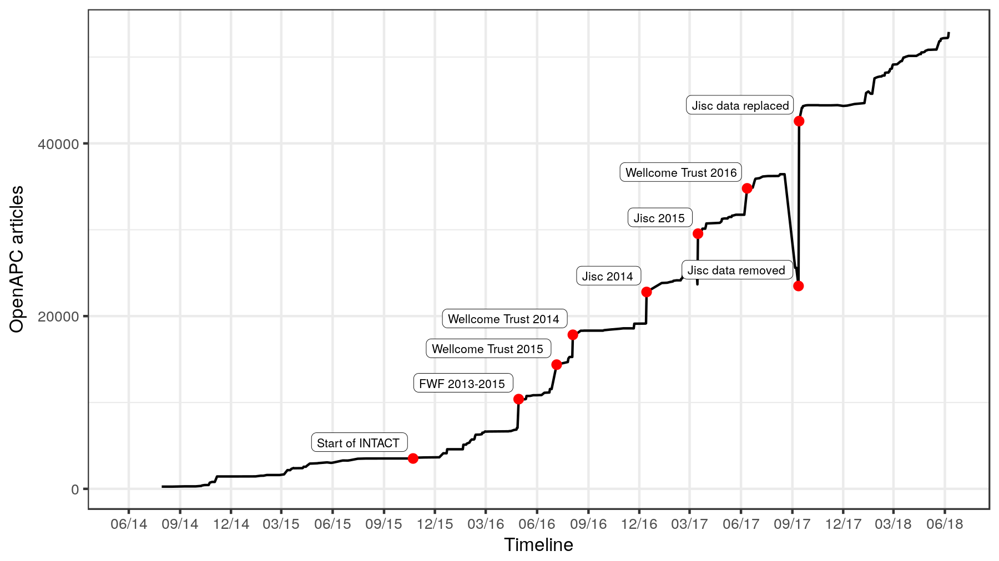

Slide 12
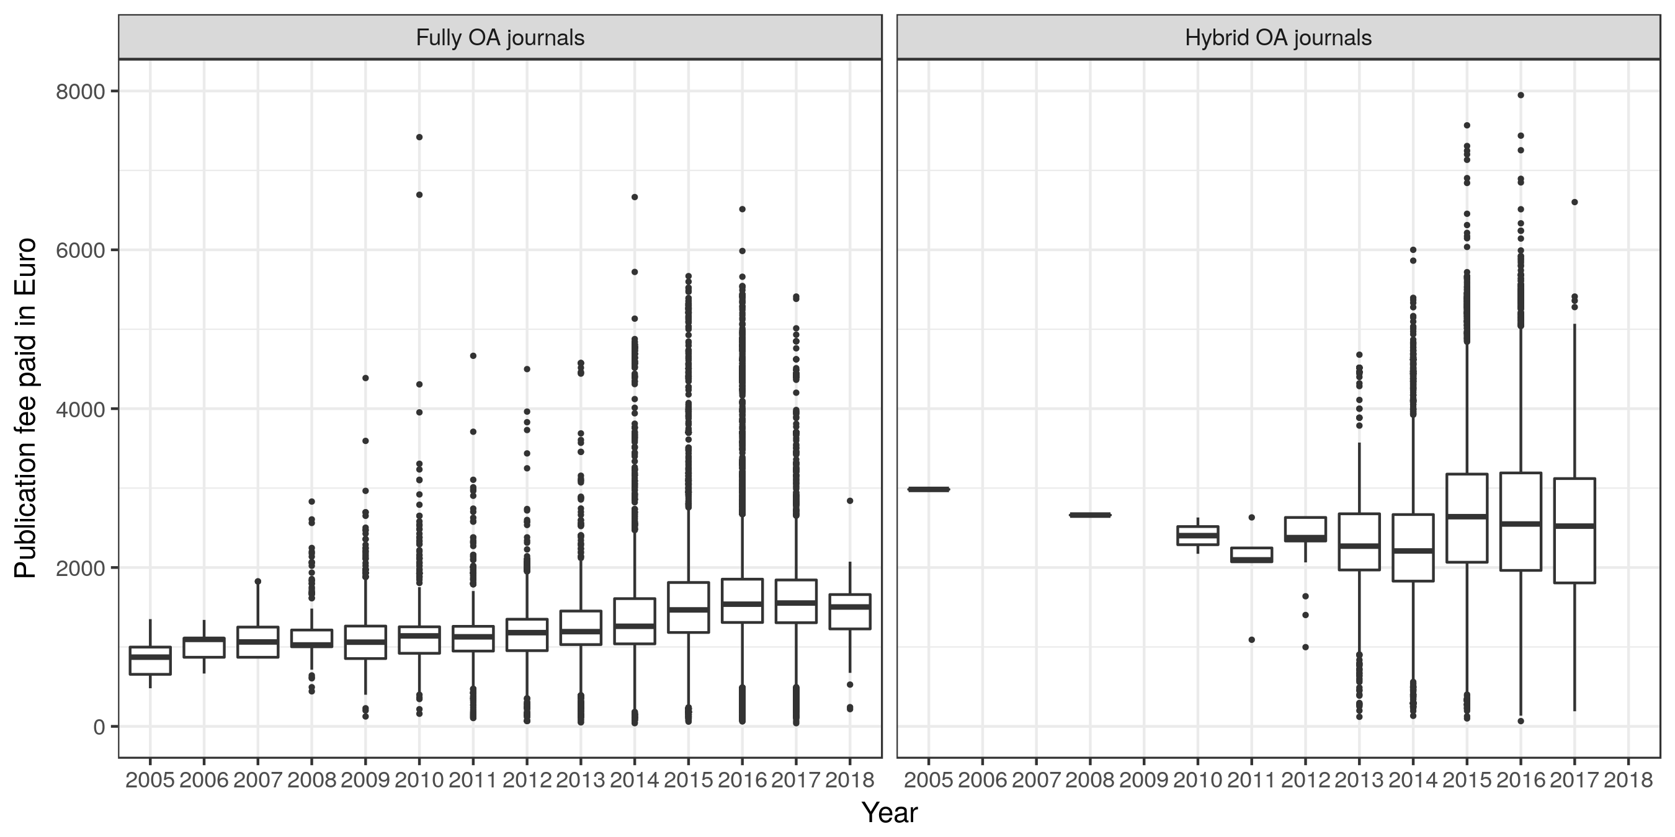
Notes:
Compact: 19310*2200=42.482.000 EURO

Slide 13
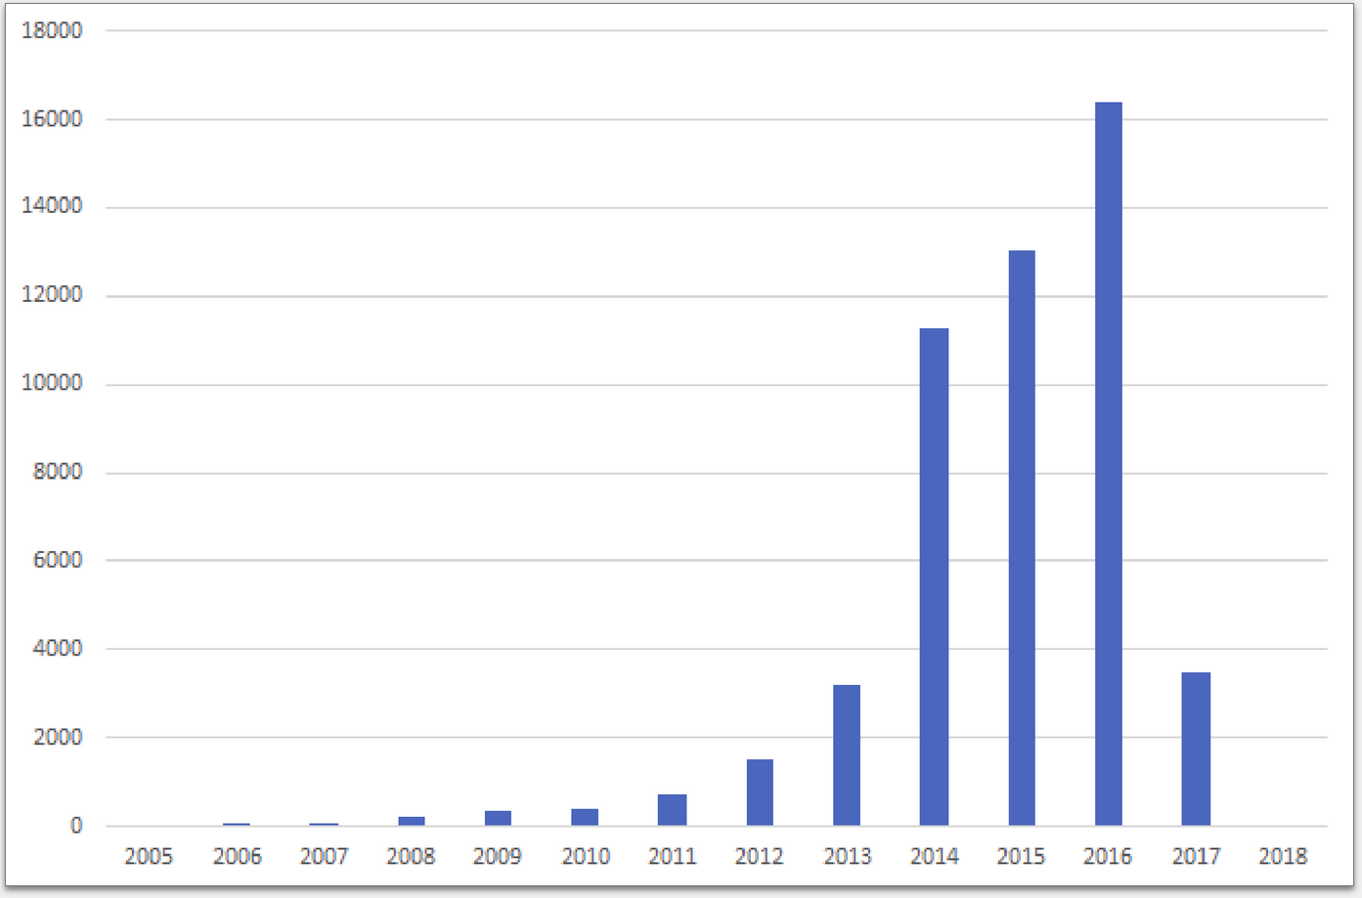
Reported APC datasets per year, Jisc und Wellcome Trust 2017 to be added

Slide 14
Some conditions for data analysis …
Choose 2015 as the base year for time series analysis
Previous year is normally complete in autumn (when Jisc an Wellcome Trust data come in)
Data set changes every time (which is also true for Crossref e.g. for the compact coverage analysis), please refer to versions
Data from eastern european countries or the global south are missing

Slide 15
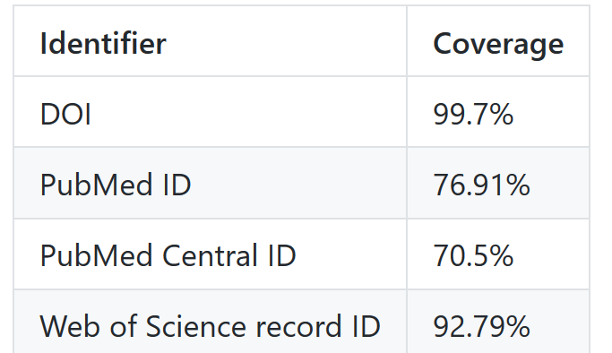
Version for some following figures
https://github.com/OpenAPC/openapc-de/tree/v3.28.7-fixed
Notes:
Compact: 19310*2200=42.482.000 EURO

Slide 16
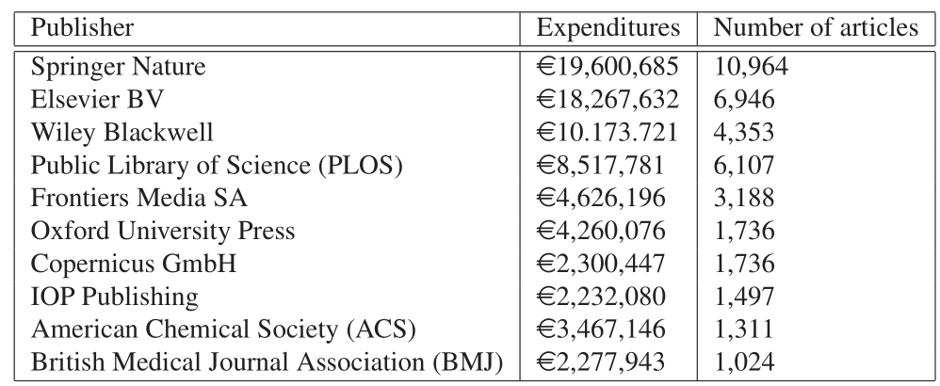
Top ten publishers regarding expenditures (v3.28.7-fixed, Springer Nature incl. BMC und Springer Business Science + Media)
Notes:
Compact: 19310*2200=42.482.000 EURO

Slide 17
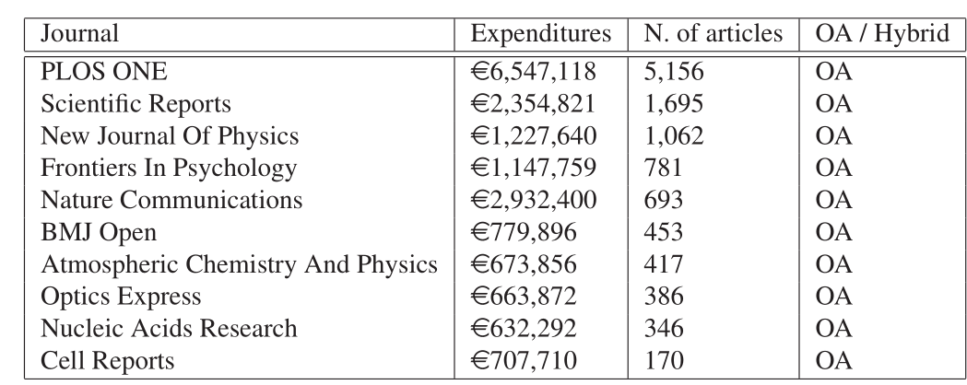
Top ten journals regarding expenditures (v3.28.7-fixed)
Notes:
Compact: 19310*2200=42.482.000 EURO

Slide 18
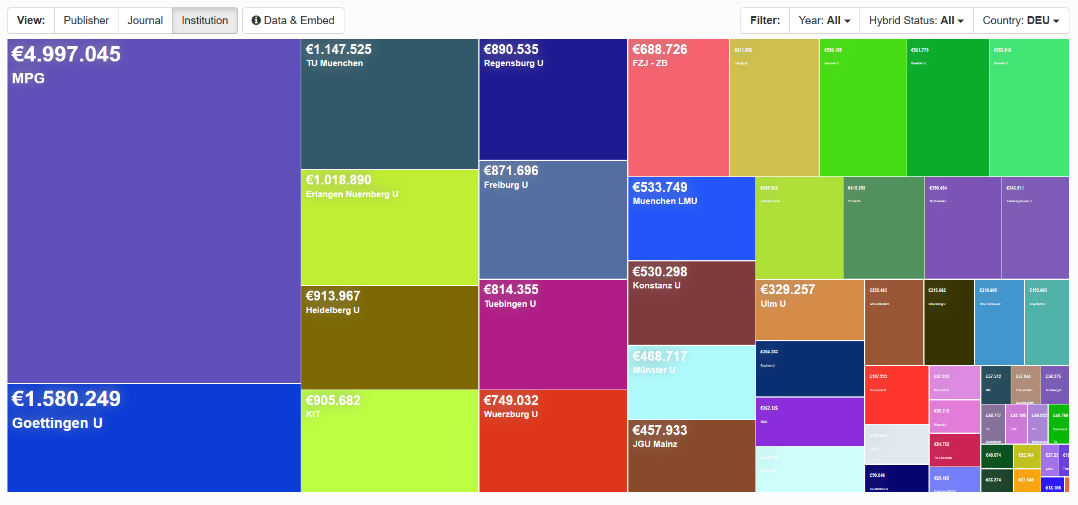
Example treemap visualisation for all german contributing institutions (v3.28.7-fixed, expenditures € 23.771.849, articles: 17.049, of which 76% are from universities)
Notes:
Compact: 19310*2200=42.482.000 EURO

Slide 19
Agenda
OpenAPC
Results so far
Springer Compact analysis
Use and reuse of OpenAPC
Cost data and price building on the APC market

Slide 20
Springer Compact analysis
Outcome of the first ESAC workshop
Data: Springer Compact reports for Bibsam, Jisc, KEMÖ, MPDL, VSNU/UKB (294 universities and research institutes), complete for 2016 and 2017
Outcomes: Offsetting dataset and Offsetting coverage dataset
“Offsetting coverage” measures offsetting and oa shares in Springer Compact journals against Springer Crossref data and Springer Link

Slide 21
Guiding questions for Springer Compact analysis
How many articles have been published in a certain journal
in a distinct period?
How many of those were published open access?
How many of those were published under offsetting
contracts?

Slide 22
Springer Compact journals with oa_share >= 50% at least in 2016 or 2017 (v3.28.7-fixed)

Slide 23
Some results of Springer Compact analysis (v3.28.7-fixed)
There was no single journal title which reached an overall
oa article share above 50% in 2016 and 2017 together
In 2017, at least one offsetting article was published in a
total of 1,347 Springer Compact journals, of which only 13
journals achieved an oa share >=50% (=0.76%)
Out of about 1,700 journals no offsetting articles have been published in around 350 titles in 2017, in another 281 journal titles we recorded only one offsetting article

Slide 24
Further perspective of offsetting analysis
Offsetting work package in the next BMBF funding phase (to process data from DEAL contracts, but we can continue and expand the existing data sets)
We like to see more data to get more evidence about how offsetting can contribute to oa transformation!

Slide 25
Agenda
OpenAPC
Results so far
Springer Compact analysis
Use and reuse of OpenAPC
Cost data and price building on the APC market

Slide 26
Some use and reuse cases of OpenAPC
Institutional OpenAPC data are used for transformation calculations, example Bielefeld UL:
Out of 2,724 subscription titles 1,336 titles are indexed in WoS (49,05%), expenditures 2015 for WoS titles: 1,282,659 €
APC break even for 447 articles: 2,869 € for Bielefeld UL

Slide 27
Some use and reuse cases of OpenAPC
OA Analytics uses OpenAPC to compile the most comprehensive liste of gold oa journals (ISSN-Gold-OA-List)
Hybrid oa dashboard
Analysing the determinants for APC-levels (OA2020-DE, Nina Schönfelder)
….

Slide 28
Some use and reuse cases of OpenAPC
OA Analytics uses OpenAPC to compile the most comprehensive liste of gold oa journals (ISSN-Gold-OA-List)
Hybrid oa dashboard
Analysing the determinants for APC-levels (OA2020-DE, Nina Schönfelder)

Slide 29
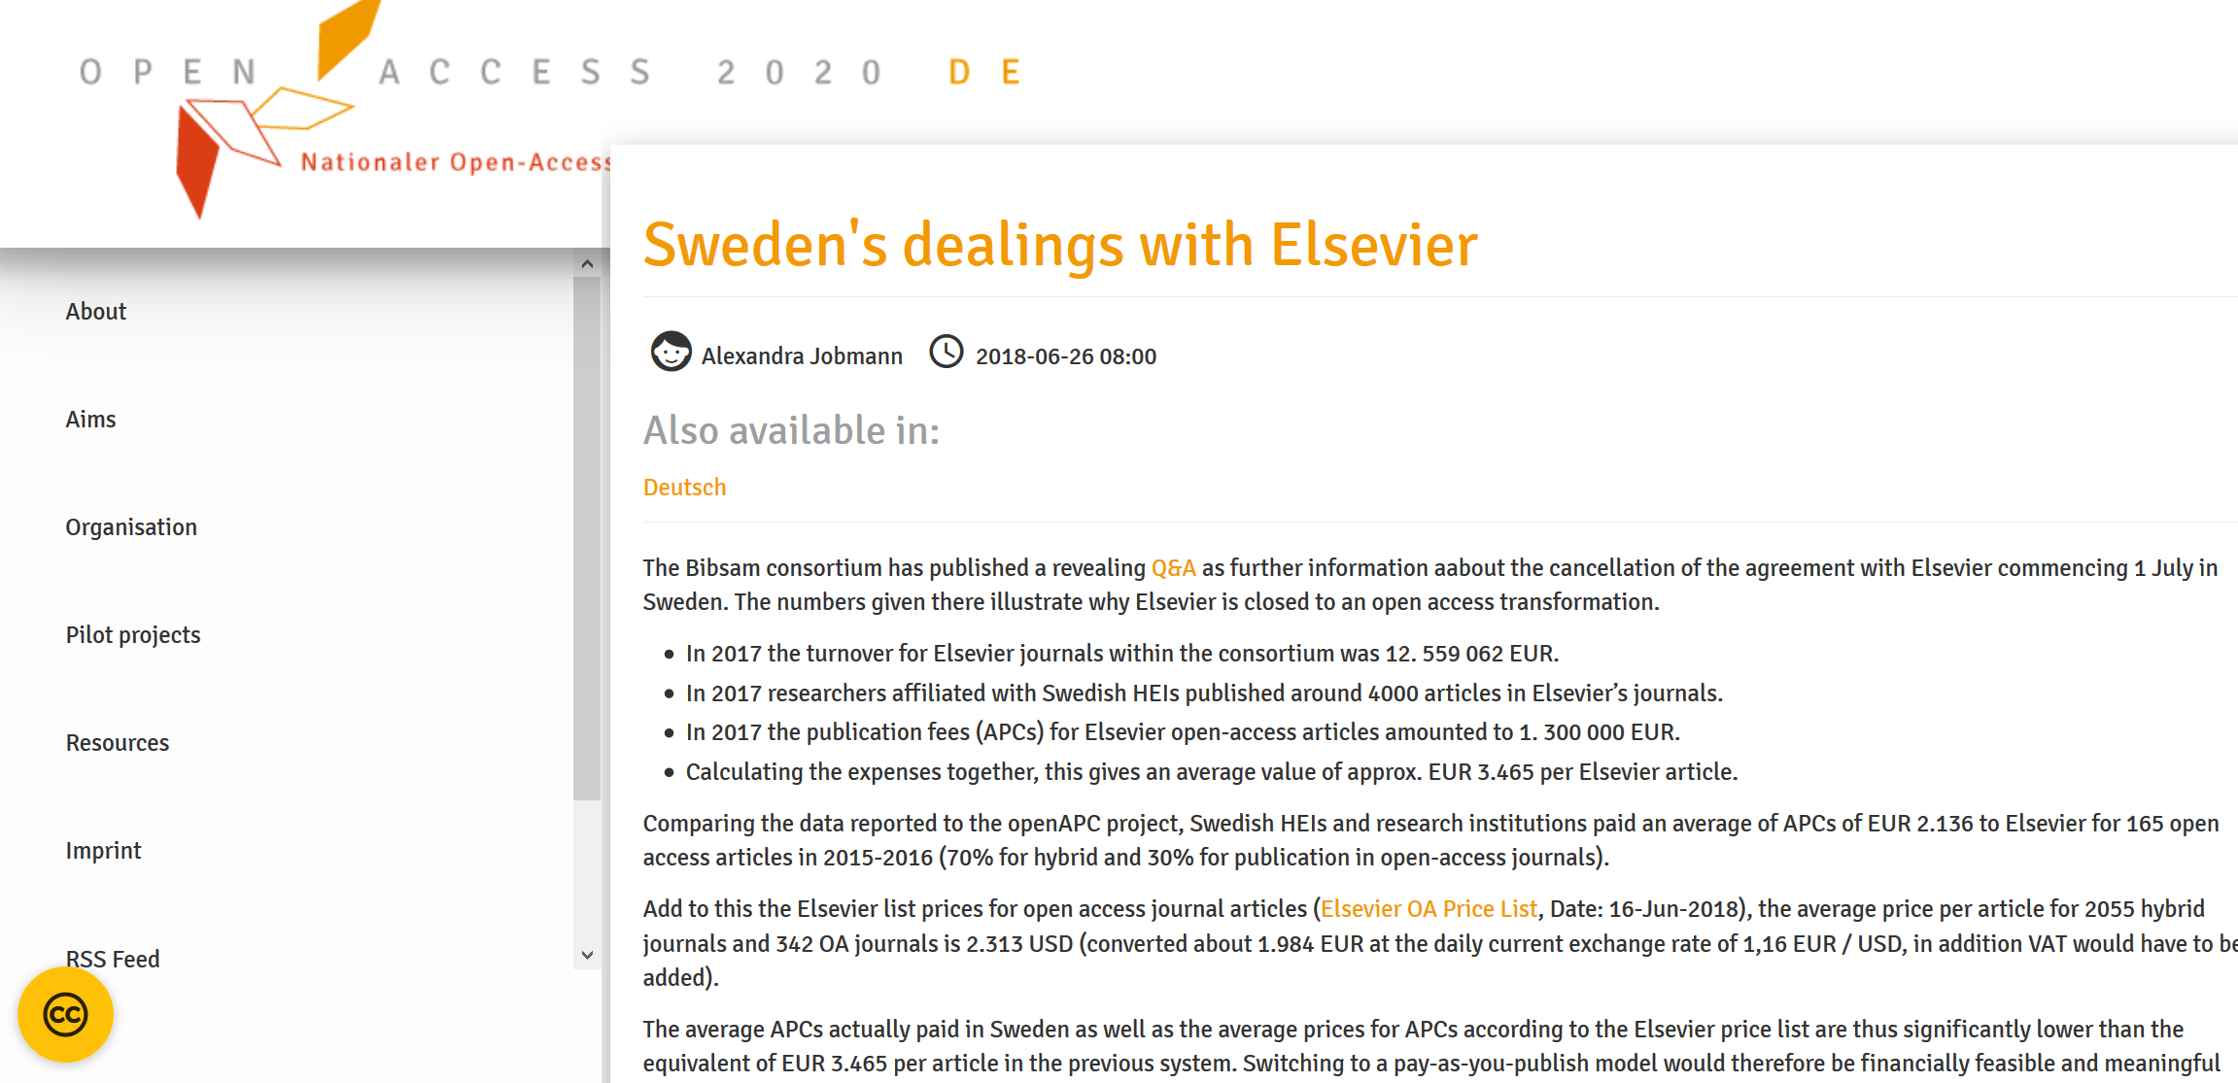

Slide 30
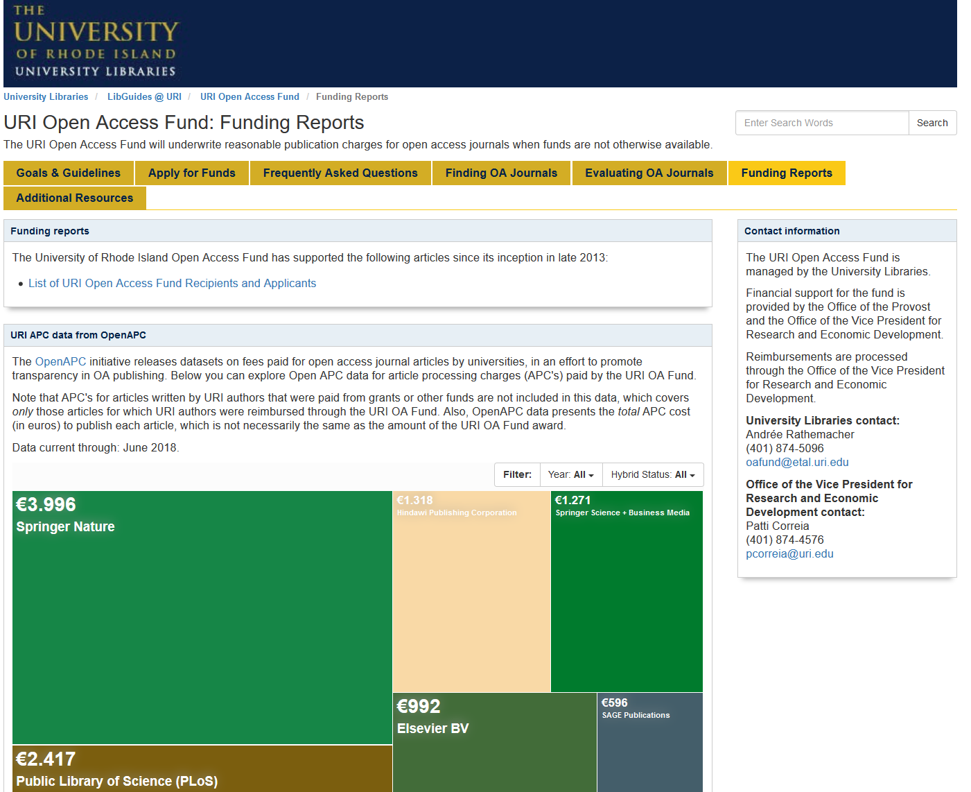

Slide 31
Agenda
OpenAPC
Results so far
Springer Compact analysis
Use and reuse of OpenAPC
Cost data and price building on the APC market

Slide 32
Price building on the APC market
Impact factor influences APC price building for oa journals more than for hybrid journals
In average, prices for hybrid articles are much higher than for oa articles within pure oa journals

Slide 33
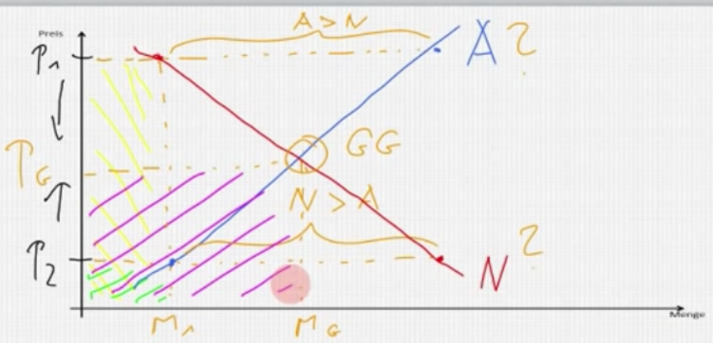
Price building in theory on a complete market

Slide 34
Price building on the APC market
APC market is an oligopoly market
Demand from libraries (consortia) and authors, which can have different preferences, especially when it comes to publishing in high impact journals

Slide 35
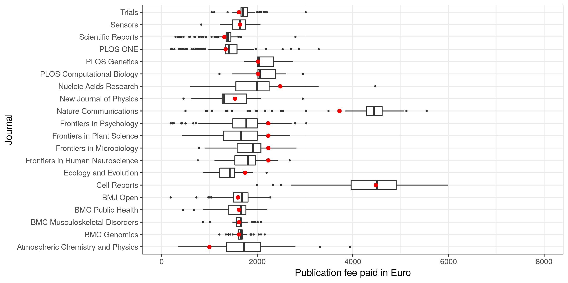
OpenAPC cost data (realised prices) and APC prices (DOAJ)

Slide 36
Price building on the APC market
There are no reasonable or fair APCs, there are only APCs, libraries (consortia) or authors are willing to pay or not
Libraries (consortia) have to decide on the market, which maximum APC (gold, hybrid, offsetting) price they are willing to pay!
OpenAPC can give evidence for hybrid and pure oa APCs!

Slide 37
Thank you!
www.intact-project.org
Follow us: @oa_intact

